Slide 1
Effective Data Presentation (Python Codes)

Slide 2
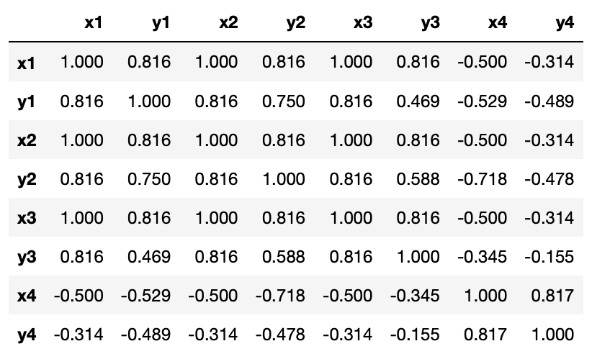
Importance of data visualization
df = pd.read_csv('anscombe_quartet.csv')
for col in df:
print(
f'{col} mean = {df[col].mean():.2f}\t'
f'{col} std = {df[col].std():.2f}'
)
df.corr().applymap(lambda x: round(x, 3))
x1 mean = 9.00 x1 std = 3.32
y1 mean = 7.50 y1 std = 2.03
x2 mean = 9.00 x2 std = 3.32
y2 mean = 7.50 y2 std = 2.03
x3 mean = 9.00 x3 std = 3.32
y3 mean = 7.50 y3 std = 2.03
x4 mean = 9.00 x4 std = 3.32
y4 mean = 7.50 y4 std = 2.03
https://github.com/d823944/AI-FIP-Training/tree/master/Effective-Data-Presentation

Slide 3
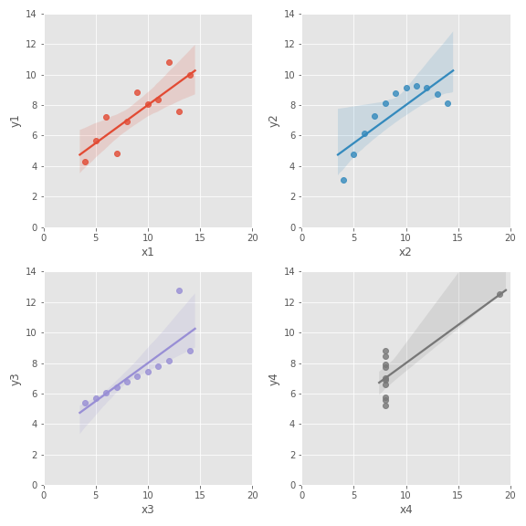
Anscombe’s quartet
fig, axes = plt.subplots(2, 2, figsize=(8, 8))
axes = axes.ravel()
cols = list(df.columns)
for i, ax in enumerate(axes):
sns.regplot(x=cols[2*i], y=cols[2*i + 1],
data=df, ax=ax)
ax.set_xlim(0, 20)
ax.set_ylim(0, 14)

Slide 4
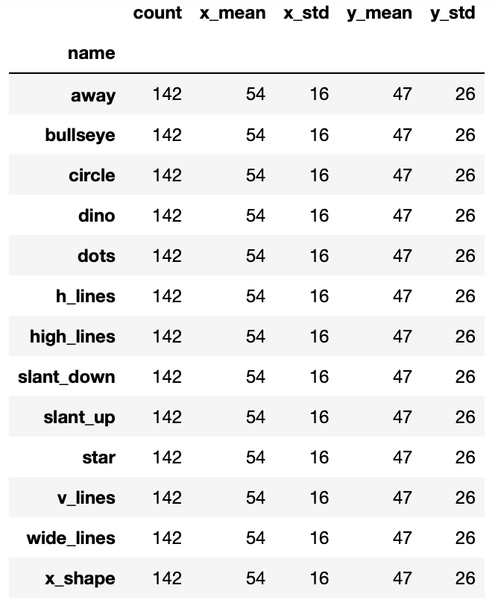
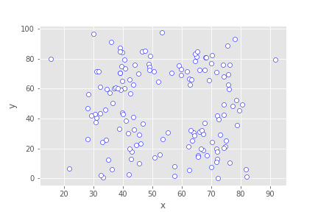
DatasaurusDozen (1 of 2)
You might be thinking about a dataset like …

Slide 5
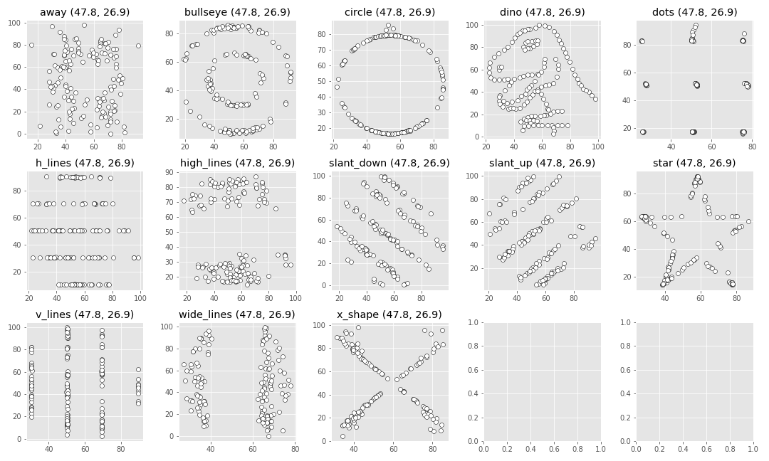
DatasaurusDozen (2 of 2)

Slide 6
Chart Selection Cheat Sheet

Slide 7
A first glance at data
(227, 20)
Country object Region object Population int64
Area (sq. mi.) int64
Pop. Density (per sq. mi.) object
Coastline (coast/area ratio) object
Net migration object Infant mortality (per 1000 births) object GDP ($ per capita) float64
Literacy (%) object
Phones (per 1000) object
Arable (%) object
Crops (%) object
Other (%) object
Climate object
Birthrate object
Deathrate object
Agriculture object
Industry object
Service object
%matplotlib inline
import numpy as np
import pandas as pd
import matplotlib.pyplot as plt
import seaborn as sns
sns.set_style('whitegrid’)
df = pd.read_csv('countries of the world.csv’)
print(df.shape)
print(df.dtypes)
Should be numerical data?

Slide 8
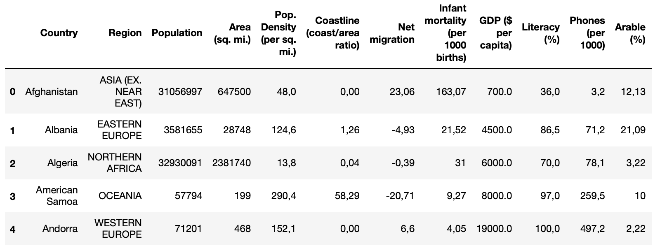
A first glance at data
df = df.applymap(lambda x: x.replace(',', '.') if (',' in str(x)) else x)
for col in df:
try:
df[col] = df[col].astype(np.float64)
except:
pass

Slide 9
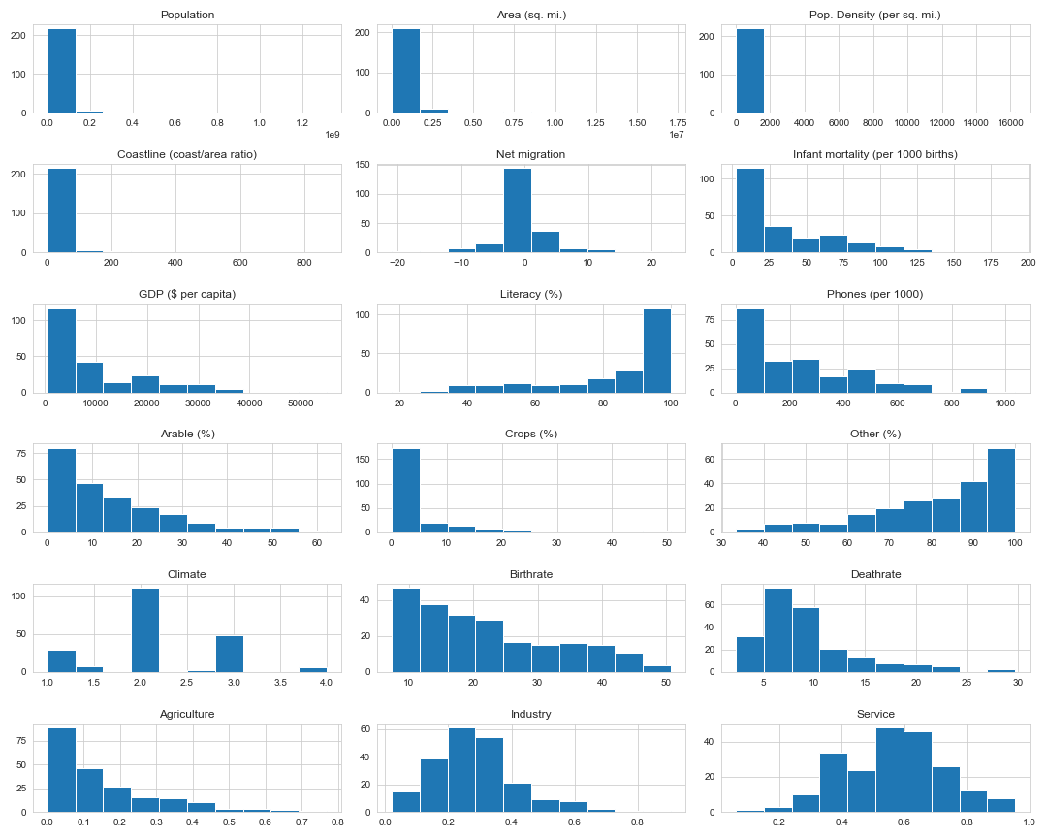
Check individual feature (Histogram)

Slide 10
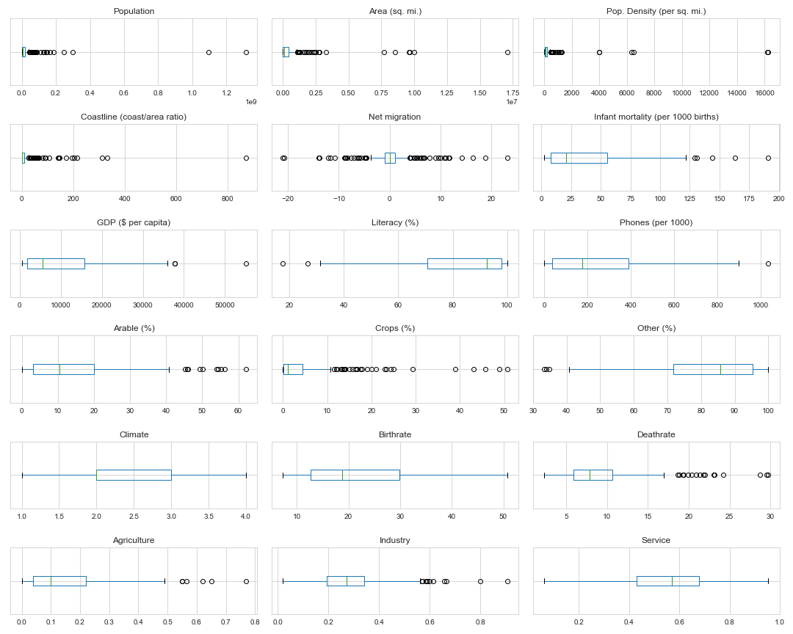
Check individual feature (Boxplot)

Slide 11
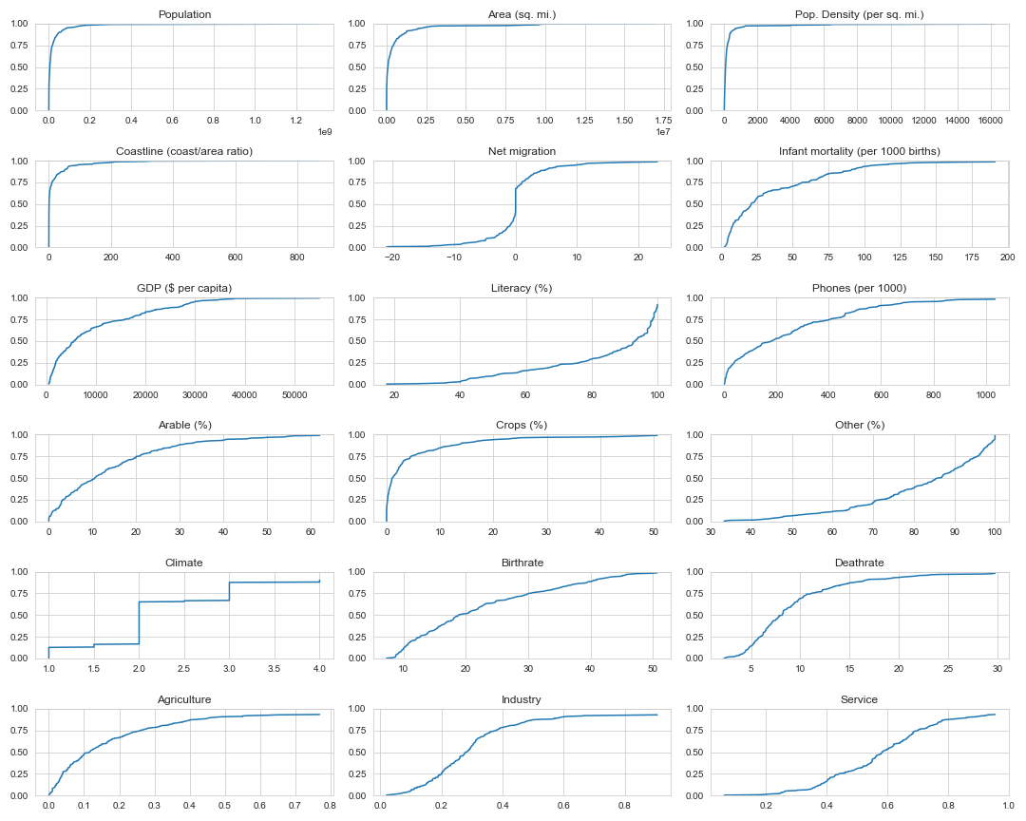
Check Empirical CDF

Slide 12
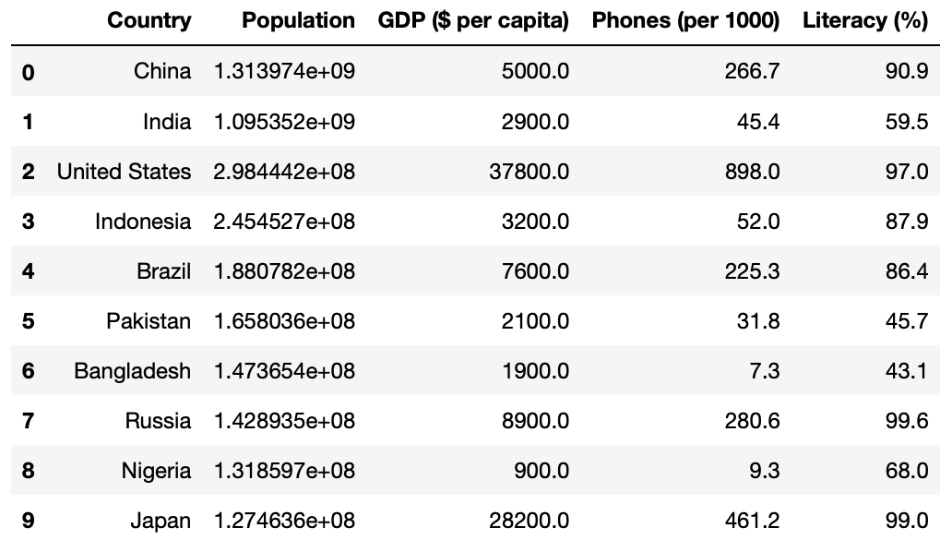
Top 10 populated country
df_gdp = df[['Country', 'Population', 'GDP ($ per capita)', 'Phones (per 1000)', 'Literacy (%)']].copy()
df_gdp.sort_values(
by=['Population’],
ascending=False, inplace=True)
df_gdp.reset_index(
drop=True, inplace=True)
df_gdp = df_gdp.iloc[:10]

Slide 13
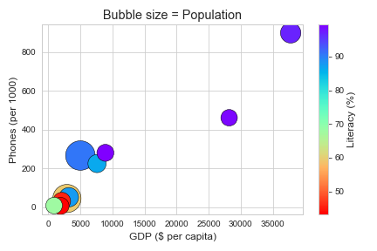
Scatter plot: features comparison (four variables)
fig, ax = plt.subplots()
CS = ax.scatter(df_gdp['GDP ($ per capita)'], df_gdp['Phones (per 1000)'],
s=np.sqrt(df_gdp['Population'] / 1e3),
c=df_gdp['Literacy (%)'], cmap=plt.cm.rainbow_r, edgecolor='k')
cbar = fig.colorbar(CS)
cbar.ax.set_ylabel('Literacy (%)’)
plt.xlabel('GDP ($ per capita)')
plt.ylabel('Phones (per 1000)')
plt.title('Bubble size = Population')
plt.tight_layout()
plt.savefig('country phone.png')

Slide 14
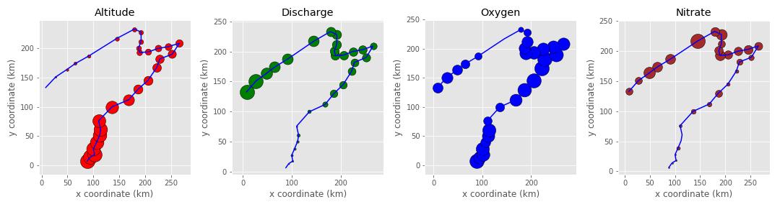
Scatter plot: three variables
fig, axes = plt.subplots(1, 4, figsize=(15, 4))
axes = axes.ravel()
cols = ['alt', 'deb', 'oxy', 'nit']
colors = ['red', 'green', 'blue', 'brown']
titles = ['Altitude', 'Discharge', 'Oxygen', 'Nitrate']
for (col, title, color, ax) in zip(cols, titles, colors, axes):
ax.plot(df_Spa['x'], df_Spa['y'], c='b')
for i in range(df_Spa.shape[0]):
ax.scatter(df_Spa['x'][i], df_Spa['y'][i], marker='o', s=marker_size[col][i] * 400, c=color, edgecolor='k')

Slide 15
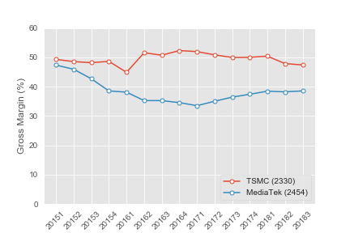
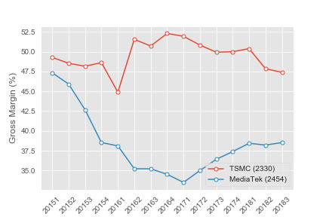
Line Graph: comparison and trend
# The vertical axis on trending charts should almost always start at zero.
plt.plot(df_tsmc.loc['Gross Margin (%)'], marker='o', markersize=5, mfc='white', label='TSMC (2330)')
plt.plot(df_mtk.loc['Gross Margin (%)'], marker='o', markersize=5, mfc='white', label='MediaTek (2454)')
plt.xticks(rotation=45)
plt.ylabel('Gross Margin (%)')
plt.legend(loc='lower right')

Slide 16
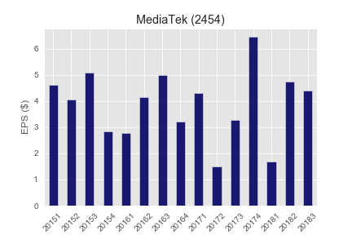
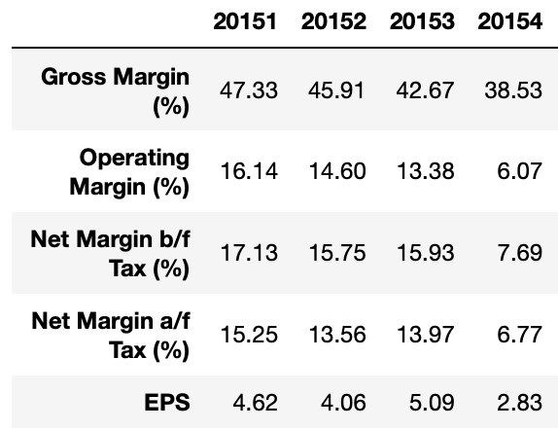
Bar Graph: comparison and trend
plt.style.use('ggplot')
df_mtk.iloc[4].T.plot(kind='bar', color='midnightblue')
plt.xticks(rotation=45)
plt.ylabel('EPS ($)')
plt.title('MediaTek (2454)')
plt.savefig('mtk eps.png')

Slide 17
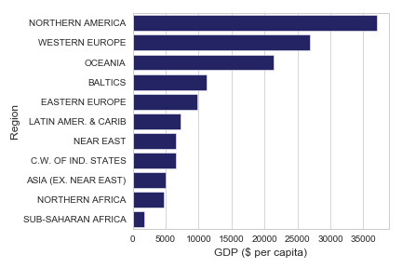
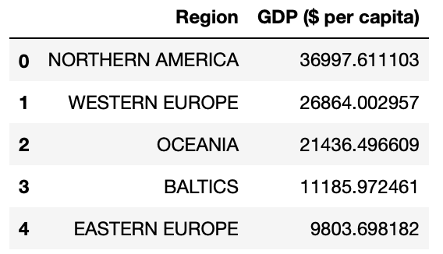
Bar Graph: ranking (sorted values)
df1 = df.copy()
df1['GDP ($)'] = df['GDP ($ per capita)'] * df['Population']
df1 = df1.groupby('Region')[['Population', 'Area (sq. mi.)', 'GDP ($)']].sum()
df1['GDP ($ per capita)'] = df1['GDP ($)'] / df1['Population']
df1.drop('GDP ($)', axis=1, inplace=True)
df1.sort_values(by='GDP ($ per capita)', ascending=False, inplace=True)
df1.reset_index(inplace=True)
df1[['Region', 'GDP ($ per capita)']].head()
sns.barplot(x='GDP ($ per capita)', y='Region’, data=df1)

Slide 18
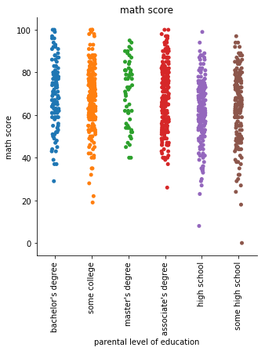
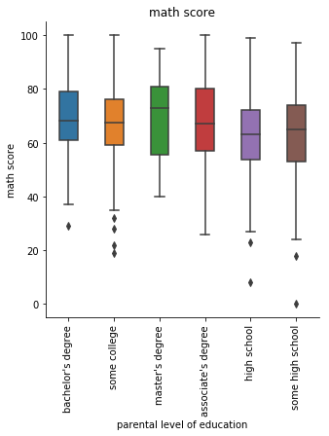
Strip/Box Plot: visualizing distribution

Slide 19
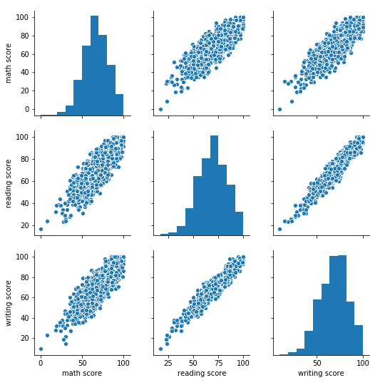
seaborn. pairplot()

Slide 20
Named colors in Matplotlib

